Slide 1
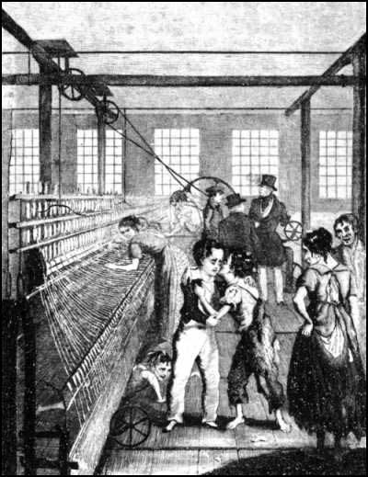
Industrial Revolution: Textile Mills

Slide 2
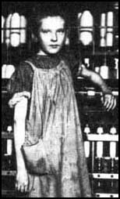
Industrial Revolution: Use of Child Labour

Slide 3
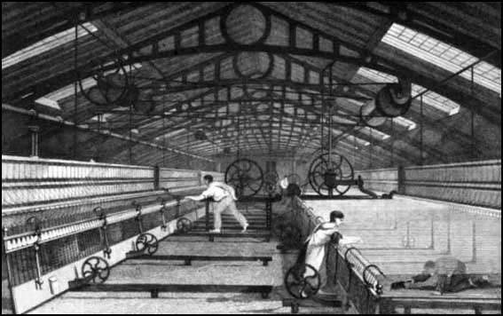
Industrial Revolution: Piercers and scavengers

Slide 4
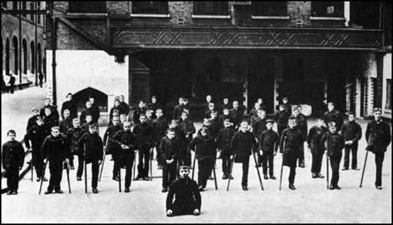
Industrial Revolution: Children crippled by factory work

Slide 5
Commodity Fetishism
Refers to the illusory nature of social relations under capitalism – where social relationships are confused with their medium, which is the commodity. Under capitalism, our life is organised through commodities:
  Eg when we work we trade our labour power (which is a commodity) for another commodity, which is money (money is the universal medium) and with this commodity we purchase other commodities.
In this situation the use-value of a commodity (the social utility of it) is separated from its exchange-value (its value in the market place)
  Eg luxury goods like diamonds, gold jewellery: the market value of these commodities is not a reflection of their usefulness (they have no intrinsic value).
There is a kind of abstraction here that is fetishistic: we attribute a value to these things which we desire, even though they are completely useless – in fact, it is often the case that more useless a thing, the more desirable it becomes.
With this sort of idealisation, he commodity takes on a kind of life of its own which is completely abstracted from the social relations – ie the labour relations that produced it and the conditions under which it was produced.

Slide 6

Commodity fetishism

Slide 7

Commodity Fetishism

Slide 8

Commodity Fetishism

Slide 9

Commodity Fetishism

Slide 10
Ideology
Ideology is an illusory or distorted view that we have of the world. Understood in two senses:
  Ideology as ruling ideas: ideas which reflect the values of the ruling bourgeois class, and which act to sustain capitalist relations. Eg:
    Human rights, equal opportunity, freedom from discrimination.
    Values such as consumerism, acquisitiveness, being responsible, hardworking, law-abiding
    Nationalism
    Religion.
  Ideology as the belief that ideas determine the material world. For Marx, this belief is an illusion: in reality, it is the material world (material forces of production) which determine ideas.
    Base-superstructure model

Slide 11
The ‘base-superstructure’ model
Superstructure Level1) Politico-legal (law and the State) Level 2) Ideology (different ideologies – religious, political, ethical, legal etc)
↑ Economic Base (Infrastructure) Mode of Production: Means of production (factories, machines etc) + Relations of production (class divisions, private property, the division of labour)

Slide 12
Theory of historical materialism
The mode of production has changed throughout history (due largely to new technologies) and with each of these changes there is a corresponding change in the form of ownership and the form of the division of labour, as well as the social and political superstructure and ruling ideas.
Major historical changes and ruptures (eg revolutions) are caused by a contradiction between the forces of production and the relations of production.
  For example, during feudal times, new forms of capitalism and new methods of industry start to emerge but these developments run up against the limit of feudal relations based on hierarchy, privilege, the ownership of large estates and bonded serfdom.
  There is a newly emerging bourgeois class which demands political recognition and rights
  Emergence of new ideas, ideologies which reflect values of the new bourgeois capitalist class (liberalism, individual rights and freedoms, questioning of absolutism, belief in merit rather than privilege)
  Hence the French Revolution (1789) as a major rupture with the old monarchical order.

Slide 13
The Dialectic
Thesis
↕ > Synthesis
Antithesis

Slide 14
Contradictions of Feudal society
Thesis (capitalist forces of production: capital accumulation,
trading, new forms of industry)
↕
Antithesis (Feudal relations of production: large estates,
bonded serfdom, privilege + feudal political relations:
nobility and Church, absolutism, divine right of kings)
> Synthesis (liberal, bourgeois capitalism: private ownership, capital accumulation, laissez faire market, developed division of labour, ideology of individualism, rights and freedoms)

Slide 15
Contradictions of Capitalist society
Thesis (new socialised forces of production:
new industrial technologies, emergence of
proletarian consciousness)
↕
Antithesis (bourgeois relations of production:
private ownership and division of labour)
Contradiction: proletarian revolution →
Communism (common ownership of the means of
production, abolition of private property, withering away of
the State)

